Slide 1

HOSTEL ATTENDANCE SYSTEM
Using Face Recognition
Notes:
Be specific and direct in the title. Use the subtitle to give the specific context of the speech.
-The goal should be to capture the audience’s attention which can be done with a quote, a startling statistic, or fact. It is not necessary to include this attention getter on the slide.

Slide 2
Group Members
MENTORED BY:
Mr. Manoj Purohit
Sumit Payal
Akanksha Tyagi
Deeksha Chhetri
Shubham Chandra
Suraj Rawat

Slide 3

INTRODUCTION
Main aim of this project is to automate the conventional hostel attendance system.
With face recognition we are reducing efforts required in available attendance systems.

Slide 4
Project details
Notes:
Dedicate this entire slide to the thesis statement. It is the reason the speech is being given. Use this time to reveal the three main points of the speech (slides 4,5,6) as an overview for the direction of the speech:
-[type main point #1 here]
-[type main point #2 here]
-[type main point #3 here]
Be sure to transition to the first main point and the next slide.

Slide 5

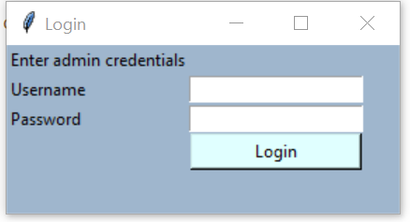
LOGIN
This section ensures admin only access.
As, all the changes in the the further sections is done by Admin only.
Notes:
The title of main point #1 should be clear and concise. Each piece of evidence should be summarized for clarity and cited correctly. Do not simply read the pieces of evidence, but elaborate where needed.
[type notes for elaboration here]
Be sure to transition to main point #2 and the next slide.

Slide 6

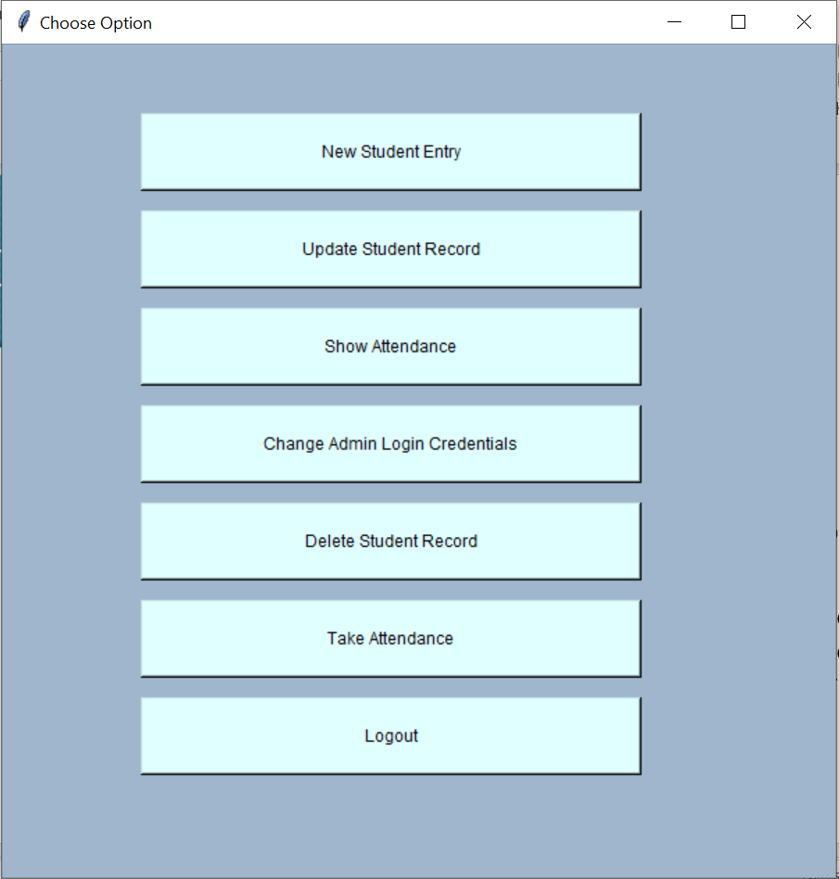
OPTIONS(HOME)
This section appears just after logging in.
Admin can perform several tasks from registering the student to deleting the record.
Notes:
The title of main point #1 should be clear and concise. Each piece of evidence should be summarized for clarity and cited correctly. Do not simply read the pieces of evidence, but elaborate where needed.
[type notes for elaboration here]
Be sure to transition to main point #2 and the next slide.

Slide 7

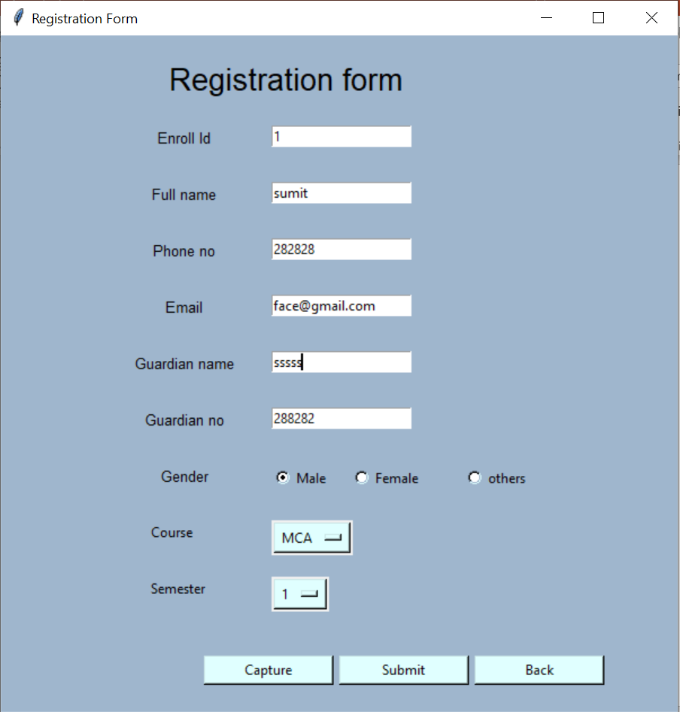
Registration
This section of UI is for registering the new student
And storing their detected face along with their details.
Notes:
The title of main point #1 should be clear and concise. Each piece of evidence should be summarized for clarity and cited correctly. Do not simply read the pieces of evidence, but elaborate where needed.
[type notes for elaboration here]
Be sure to transition to main point #2 and the next slide.

Slide 8
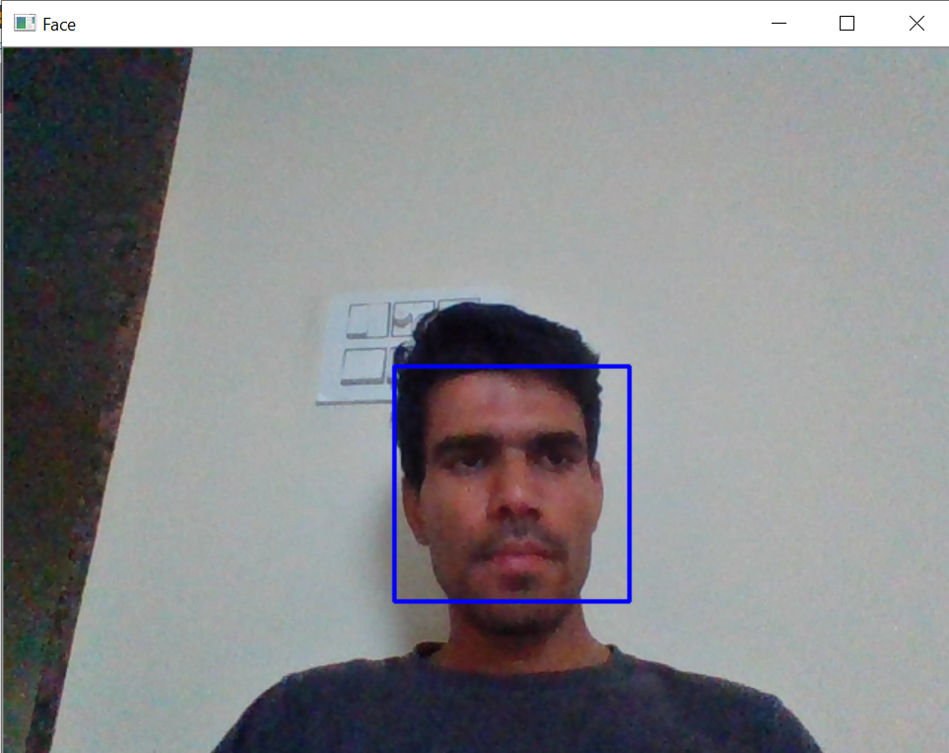
Registration(cont..)
Clicking on capture button leads to this part where we capture the image of a student at the time of registration.

Slide 9
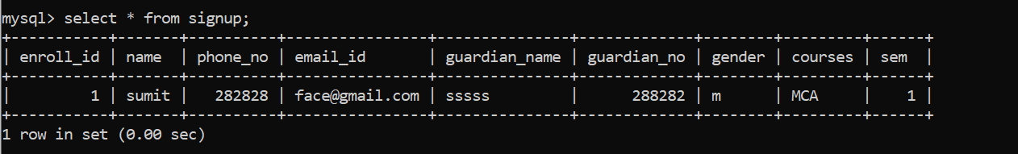
Registration(cont..)
All the details of the student get stored after submission.

Slide 10

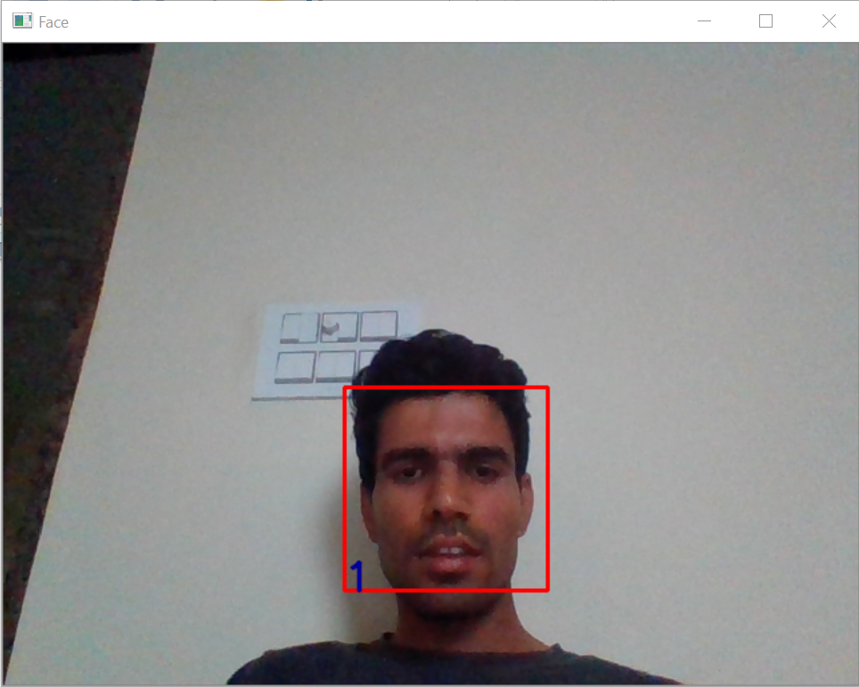
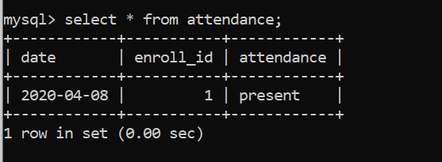
ATTENDANCE
Clicking on Take attendance button leads to this section where all the detected faces are recognised
And attendance of that particular student get stored in database.
Notes:
The title of main point #2 should be clear and concise. Each piece of evidence should be summarized for clarity and cited correctly. Do not simply read the pieces of evidence, but elaborate where needed.
[type notes for elaboration here]
Be sure to transition to main point #3 and the next slide.

Slide 11
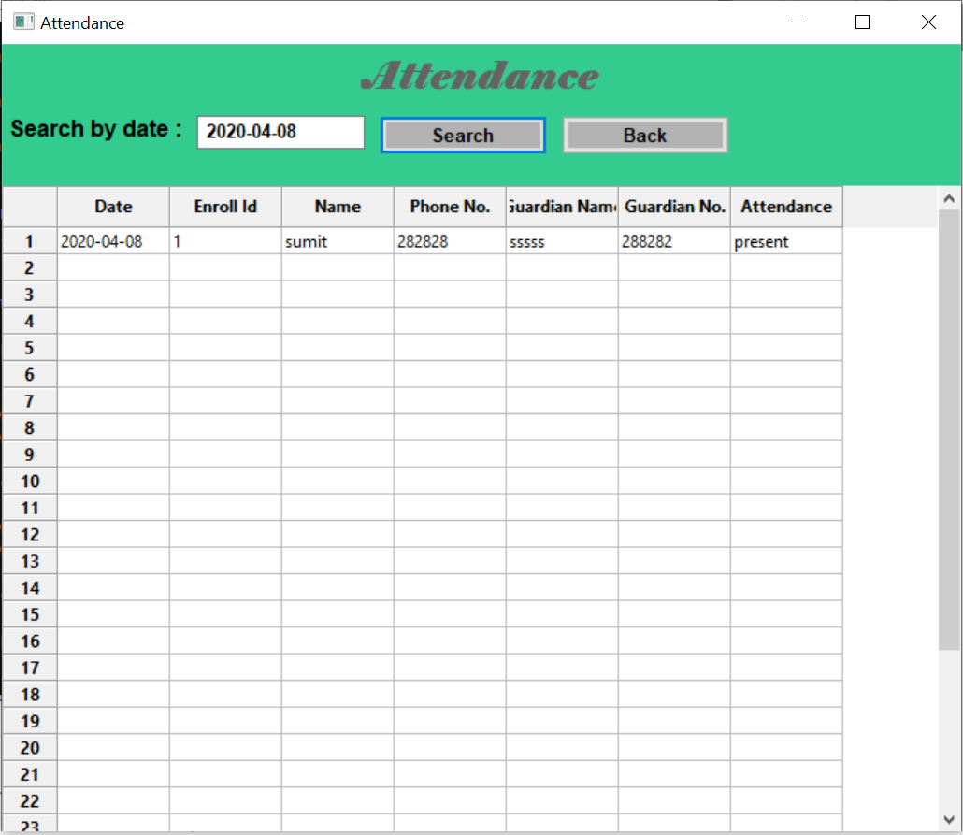
ATTENDANCE (cont..)
Show attendance section shows all the students present.
Search by date option is to check the attendance of any specific day.

Slide 12

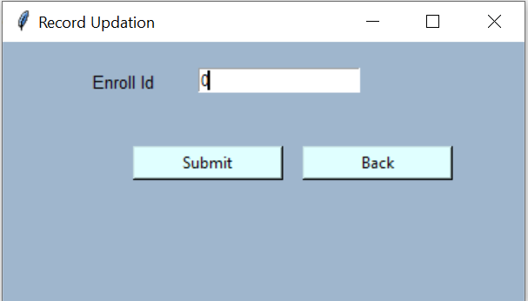
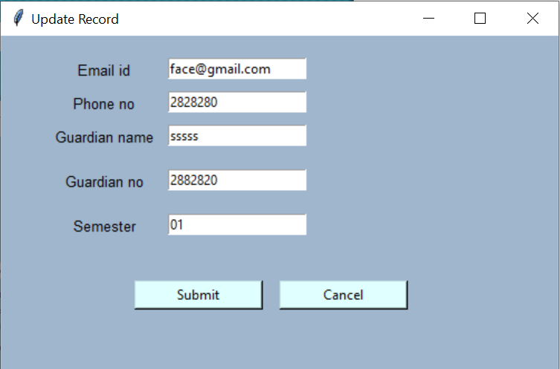
Update record
This section is to update the changes in record of a student.
Process requires enrolment id of pre-existing student to update record.
Notes:
The title of main point #1 should be clear and concise. Each piece of evidence should be summarized for clarity and cited correctly. Do not simply read the pieces of evidence, but elaborate where needed.
[type notes for elaboration here]
Be sure to transition to main point #2 and the next slide.

Slide 13
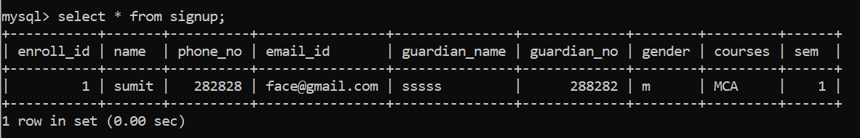
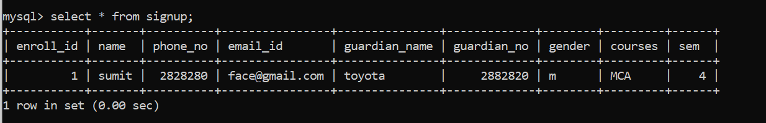
Update record(cont..)
Changes reflected in database.

Slide 14

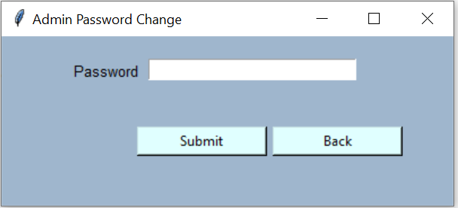
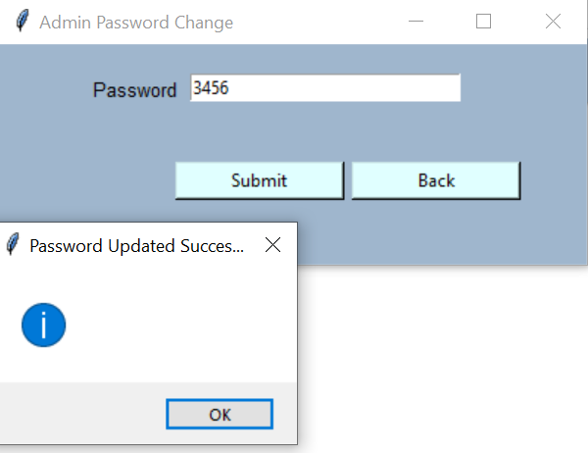
Change Admin credentials
This section ensures that admin can change his/her password whenever he/she want to.
Notes:
The title of main point #3 should be clear and concise. Each piece of evidence should be summarized for clarity and cited correctly. Do not simply read the pieces of evidence, but elaborate where needed.
[type notes for elaboration here]
Be sure to transition to the counterargument and the next slide.

Slide 15

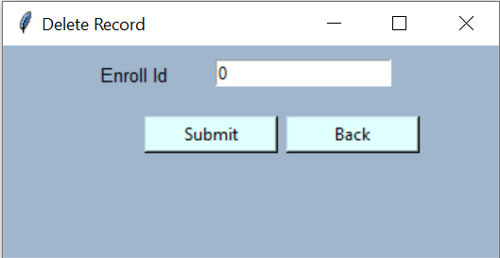
Deleted records
This section is to delete the records of the students who are no longer staying in the hostel.
Notes:
The title of main point #2 should be clear and concise. Each piece of evidence should be summarized for clarity and cited correctly. Do not simply read the pieces of evidence, but elaborate where needed.
[type notes for elaboration here]
Be sure to transition to main point #3 and the next slide.

Slide 16
References
https://www.google.com/url?q=https://stackoverflow.com/questions/45510477/python-tkinter-how-to-read-the-second-drop-down-values
https://www.google.com/url?q=https://github.com/shashankch292/Face-Detection-Recognition-Based-Attendance
https://www.google.com/url?q=https://github.com/shashankch292/Face-Detection-Recognition-Based-Attendance-System/tree/master
https://www.google.com/url?q=https://docs.opencv.org/2.4/modules/contrib/doc/facerec/facerec_tutorial.html

Slide 17

Thank you
Notes:
The action step is what the audience is supposed to do or think about the topic. It should be one sentence that is written clearly and with much thought. It may also be the thesis statement restated as an action. The goal of this slide is to leave the audience with a clear message as to what they are to do or think at the end of the speech. It may be a good idea to end with a powerful quote or image.

